Slide 1
MedVoice Design Document
Created by: Holly Do

Slide 2
Contents
Introduction
Data Dictionary
Trade Study
Screen Images
Prioritization Matrix

Slide 3
Introduction
Purpose
This software design document describes the architecture and system design of the MedVoice application.
Scope
This document will focus on the GUI of the MedVoice application.

Slide 4
Data Dictionary
Data Element | Description | Composition/Data Type | Length
Care Client | A registered user of MedVoice. | +User’s email address +User’s date of birth
Care Client’s email address | The Care Client’s email address | Alphanumeric | 30
Care Client’s date of birth | The date of birth of the Care Client’s | Date MM/DD/YYYY | 10
Ad Payment | Information about ads’ payment from advertisers to MedVoice | Payment amount +Payment method +Transaction number
Payment Amount | The amount paid to MedVoice from advertiser for ad placement | Numeric, dollars, and cents | dddddd.cc
Payment Method | The method that advertiser used to pay MedVoice for ad placement | Alphabetic | 16
Transaction Number | MedVoice system assigned a unique number for each payment transaction | Integer | 12

Slide 5
Trade Study
Quality Attribute | Bootstrap | Foundation
Performance | 7 | 7
Ease of Use | 7 | 6
Compatibility | 10 | 9
Supportability | 8 | 4
Productivity | 7 | 4
Responsiveness | 6 | 2
Total | 45 | 32

Slide 6
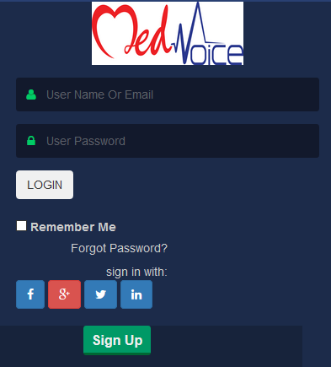
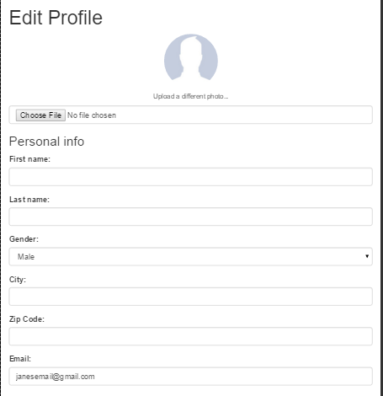
Screen Images

Slide 7
Prioritization Matrix
Priority = value %/(cost % * cost weight) + (risk % * risk weight)
Feature | Benefit | Penalty | Total Value | Cost | Cost % | Risk | Risk % | Priority
FR-1 | 9 | 7 | 16 | 4 | 10.5 | 2 | 7.69 | 0.880
FR-2 | 8 | 6 | 14 | 2 | 5.26 | 2 | 7.69 | 1.08
FR-3 | 7 | 4 | 11 | 6 | 15.8 | 7 | 26.9 | 0.258
FR-4 | 2 | 3 | 5 | 1 | 2.63 | 1 | 3.85 | 0.772
FR-5 | 1 | 2 | 3 | 2 | 5.26 | 3 | 11.5 | 0.179
FR-6 | 6 | 7 | 13 | 7 | 18.4 | 7 | 26.9 | 0.287
FR-7 | 8 | 8 | 16 | 8 | 21.1 | 1 | 3.85 | 0.641
FR-8 | 8 | 7 | 15 | 6 | 15.8 | 1 | 3.85 | 0.763
FR-9 | 2 | 2 | 4 | 2 | 5.26 | 2 | 7.69 | 0.309
Total | 51 | 46 | 97 | 38 | 100% | 26 | 100%

Slide 8
Prioritization Matrix Continued
Highest Priority
FR-2: Login
FR-1: Register for an Account
FR-4: Edit Profile
FR-8: Obtain Service from Caregiver
FR-7: Connect with Another Care Client
FR-9: Edit Health History
FR-6: Search Database for a Specific Disease
FR-3: Purchase Report
FR-5: Delete Account

